Slide 1
EMCL Projects at NICTA
Andrea Condoluci
Matteo Manighetti

Slide 2
Do you know the one about the italians who went to Australia?
We did our project at NICTA last summer, and we think you should too
So we are giving an informal presentation
With a lot of bullet points
And a lot of pictures
We hope you will find it helpful!

Slide 3
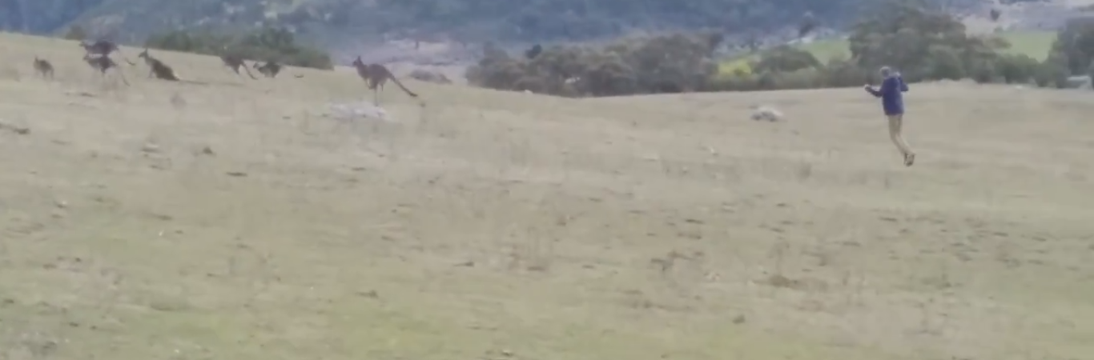
Matteo jumping after kangaroos
(No, I didn’t reach them)

Slide 4
Doing your project at NICTA/Data61
You will have to do the project at some point
What if I am behind with exams?
You will work during summer: not fun, but you actually gain time for your studies
You will have the chance to go to Australia! Now, that’s fun

Slide 5
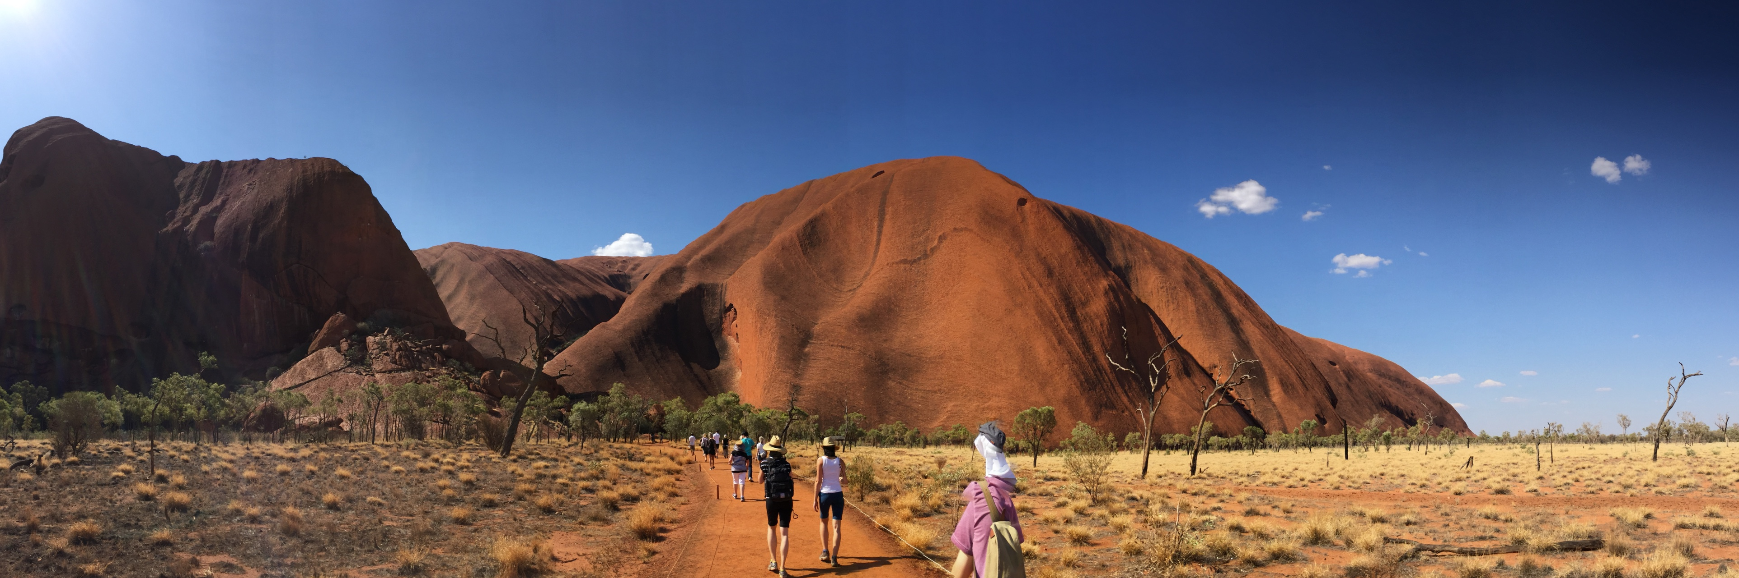
Greetings from the red center!

Slide 6
The costs
If you have a scholarship: you already get a lot of money
If you don't, and are from EU: you will get 3000 €
From our experience: 1500€ travel, 1500€ 2 months rent (Sydney prices)
Therefore: you’ll need the usual money for living, plus some additional for travelling and fun (time to break your piggy bank?)
Living is quite expensive (you’ll probably be in big cities). But low Australian dollar helps!

Slide 7
The benefits
Great chance to travel!
Thriving environment at NICTA
Lots of topics for all the tastes from the various research groups
You will find many people coming from EMCL down there! And… you could be the next one

Slide 8
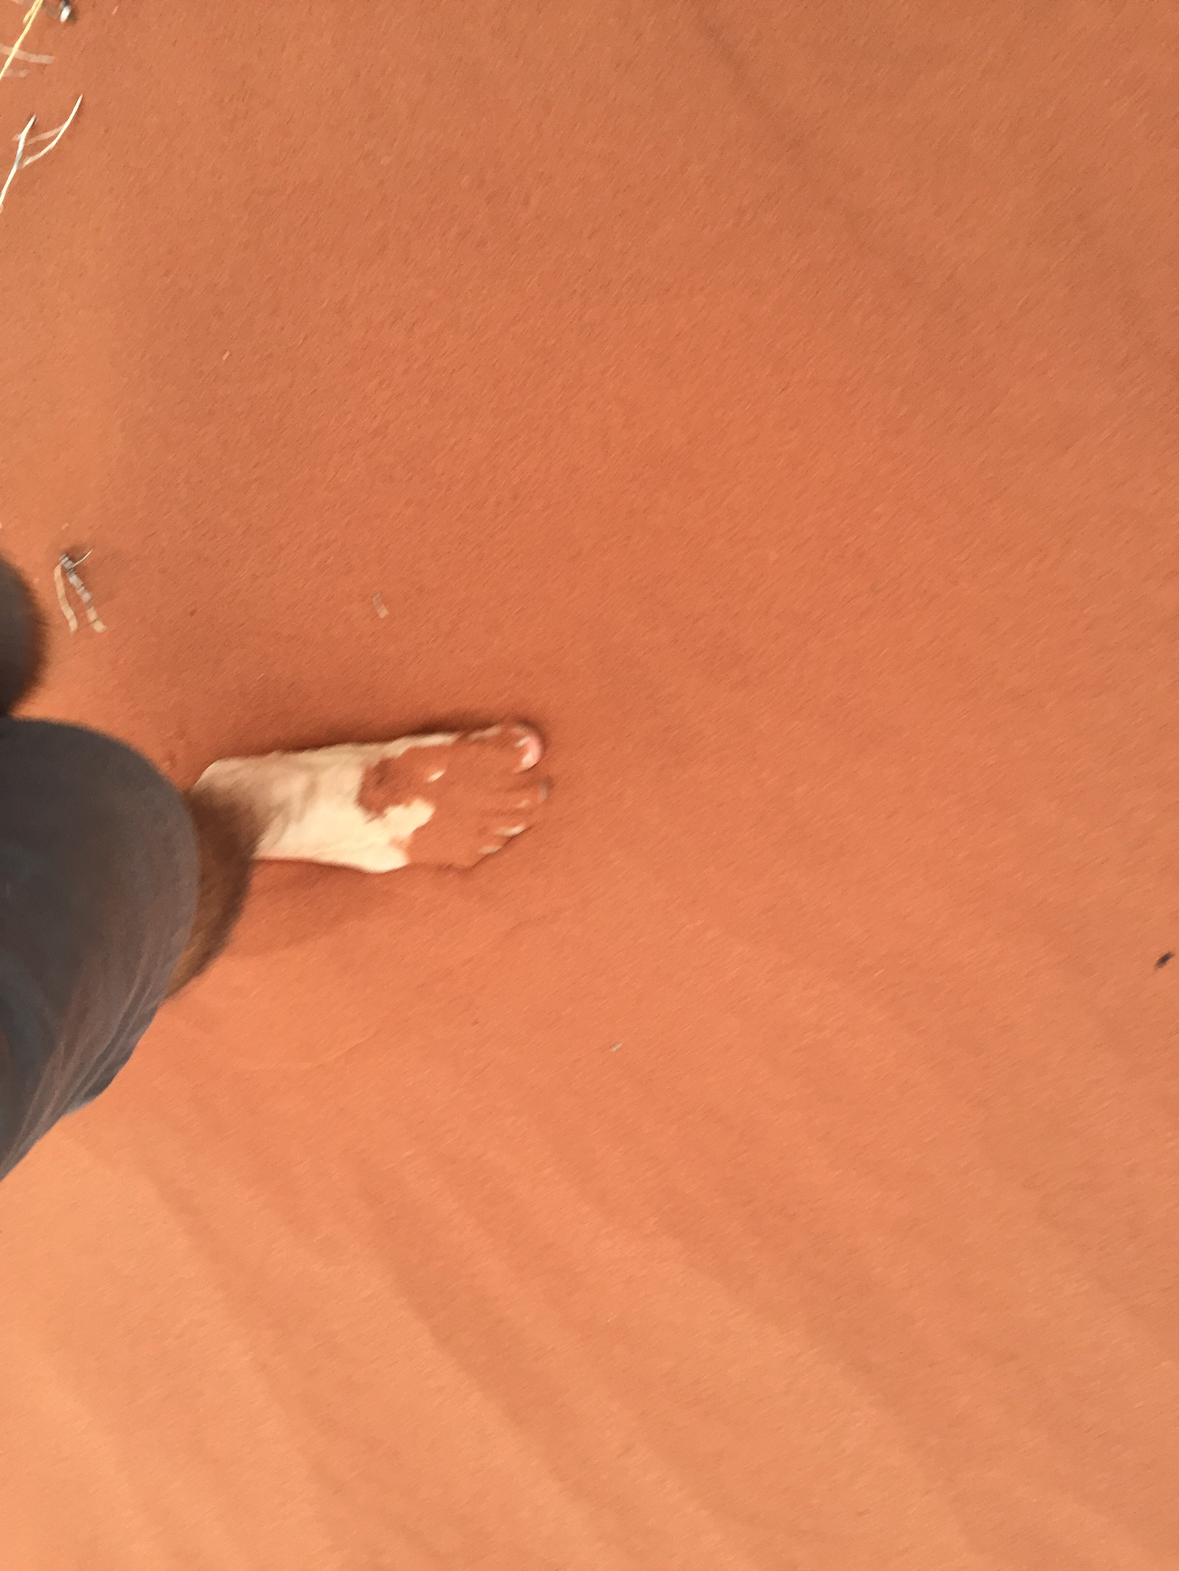
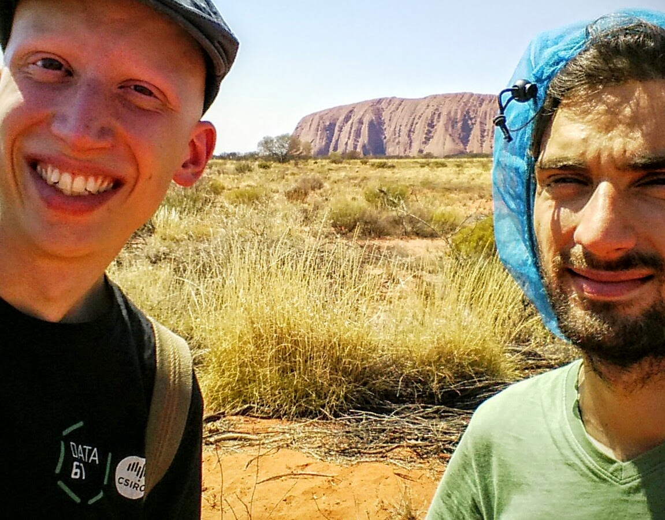

Slide 9
Caveats
Make up your mind very quickly!
Immigration procedure can be extremely long (and if you are from EU, you might not be used to visa applications)
If you are from the EU, you might even still not have a passport! (It was our case)
Official time for getting a class 402 visa: 16 weeks at most. How much it took for me: 16 weeks. Don't be optimistic.

Slide 10
Some information on visas
You will need a class 402 ("Occupational Trainee")
Good news: NICTA handles most of the bureaucracy
You will just have to fill in a lot of paperwork and they will take care of sponsoring the application
...but it will still require a lot of time to be processed
Be prepared to stay awake at night to call offices at the local timezone

Slide 11
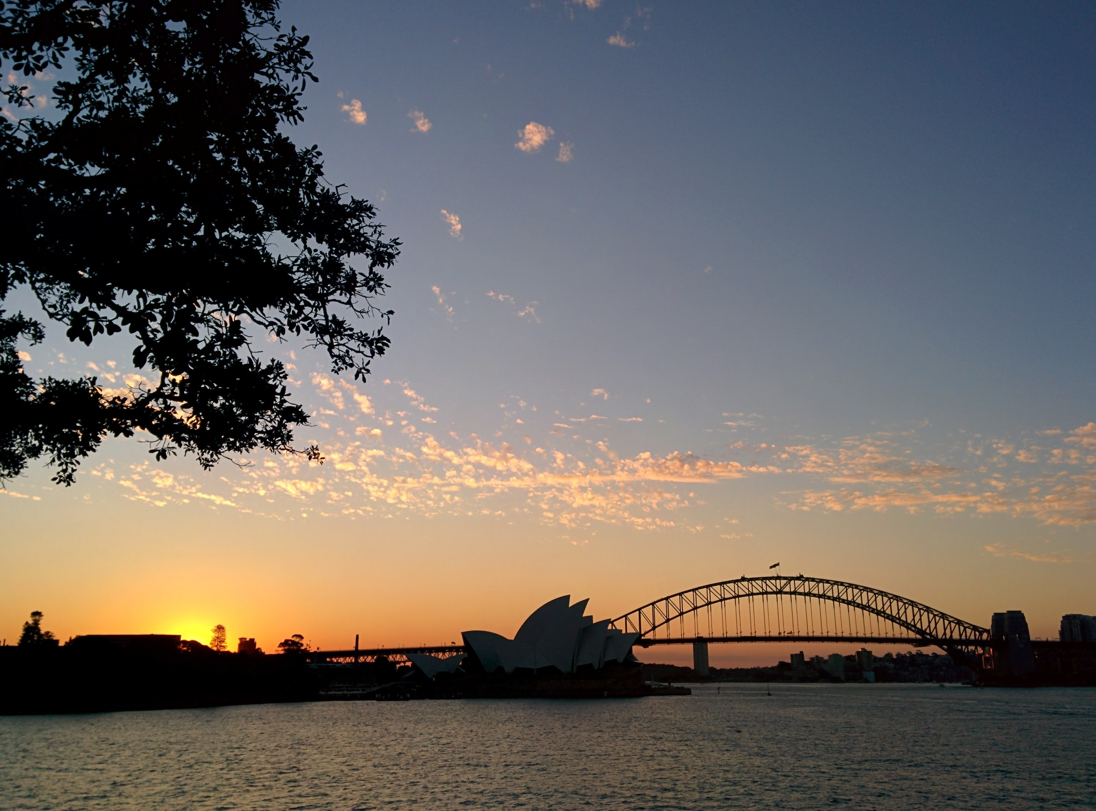
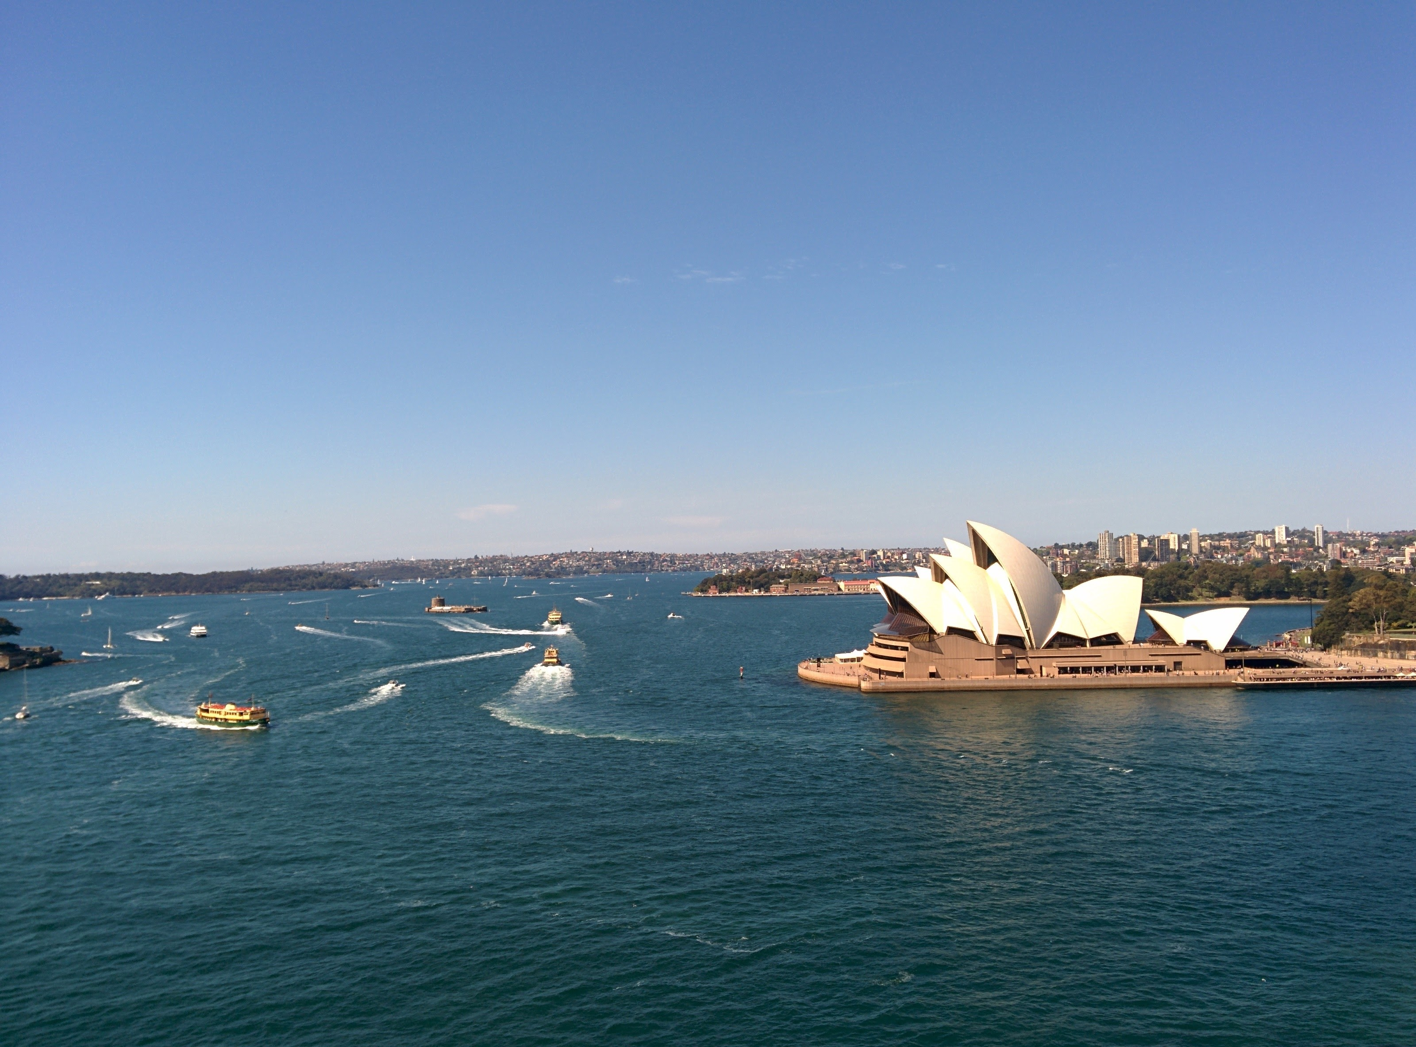
Every picture of the Opera House you take looks perfect!

Slide 12
What should you do right now?
Have a look at the topics in NICTA's EMCL page: https://ssrg.nicta.com.au/students/emcl.pml
Take note of the names related to the topics you like, and send emails to ask about current projects
Once you think you might have found something interesting, go for it!
You will have time to further define the topic later.
Finding a local supervisor at the second year uni is not an issue.

Slide 13
NICTA offices in Canberra

Slide 14
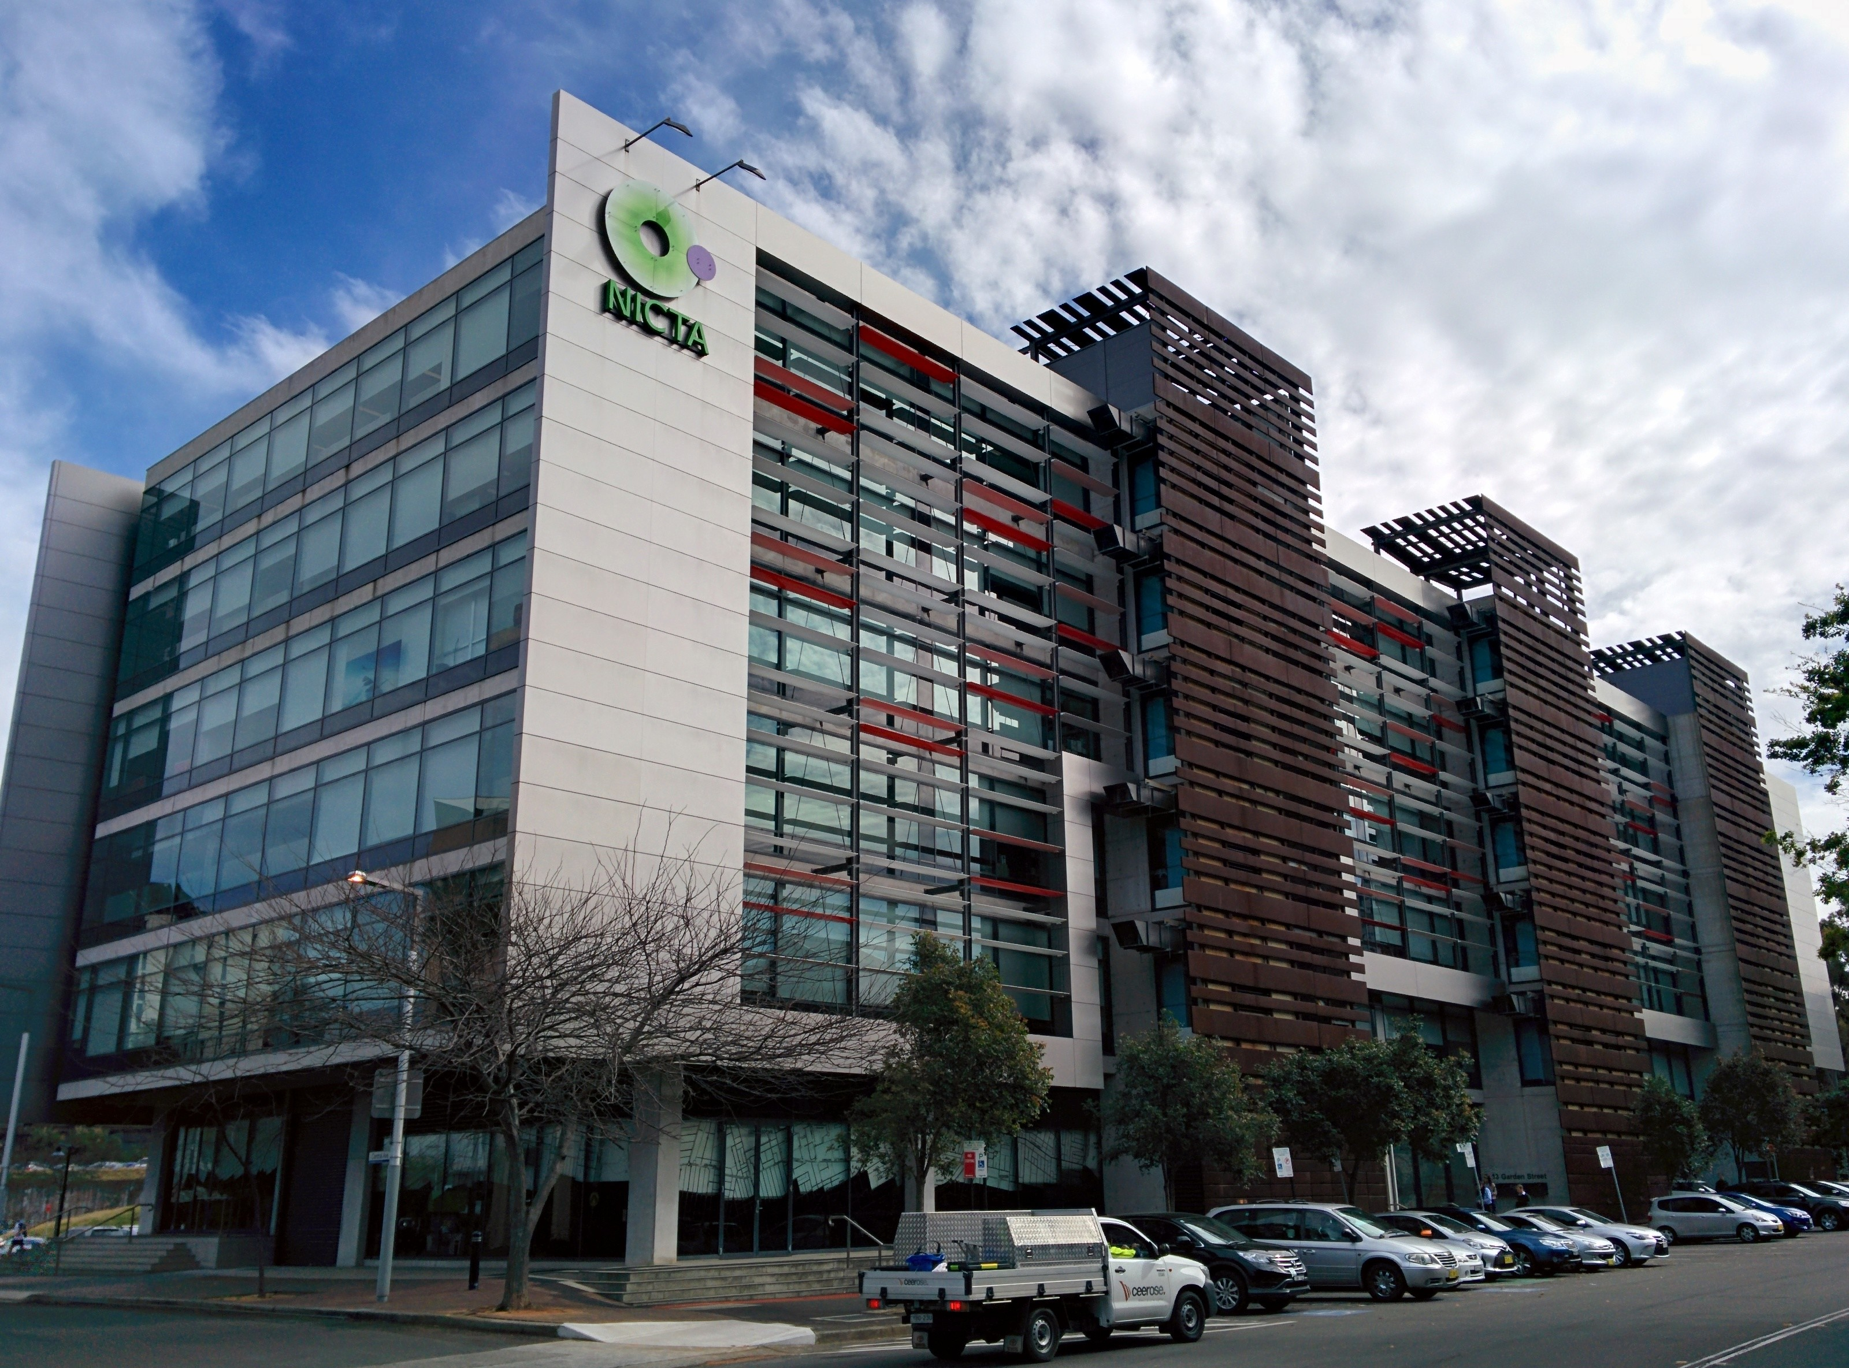
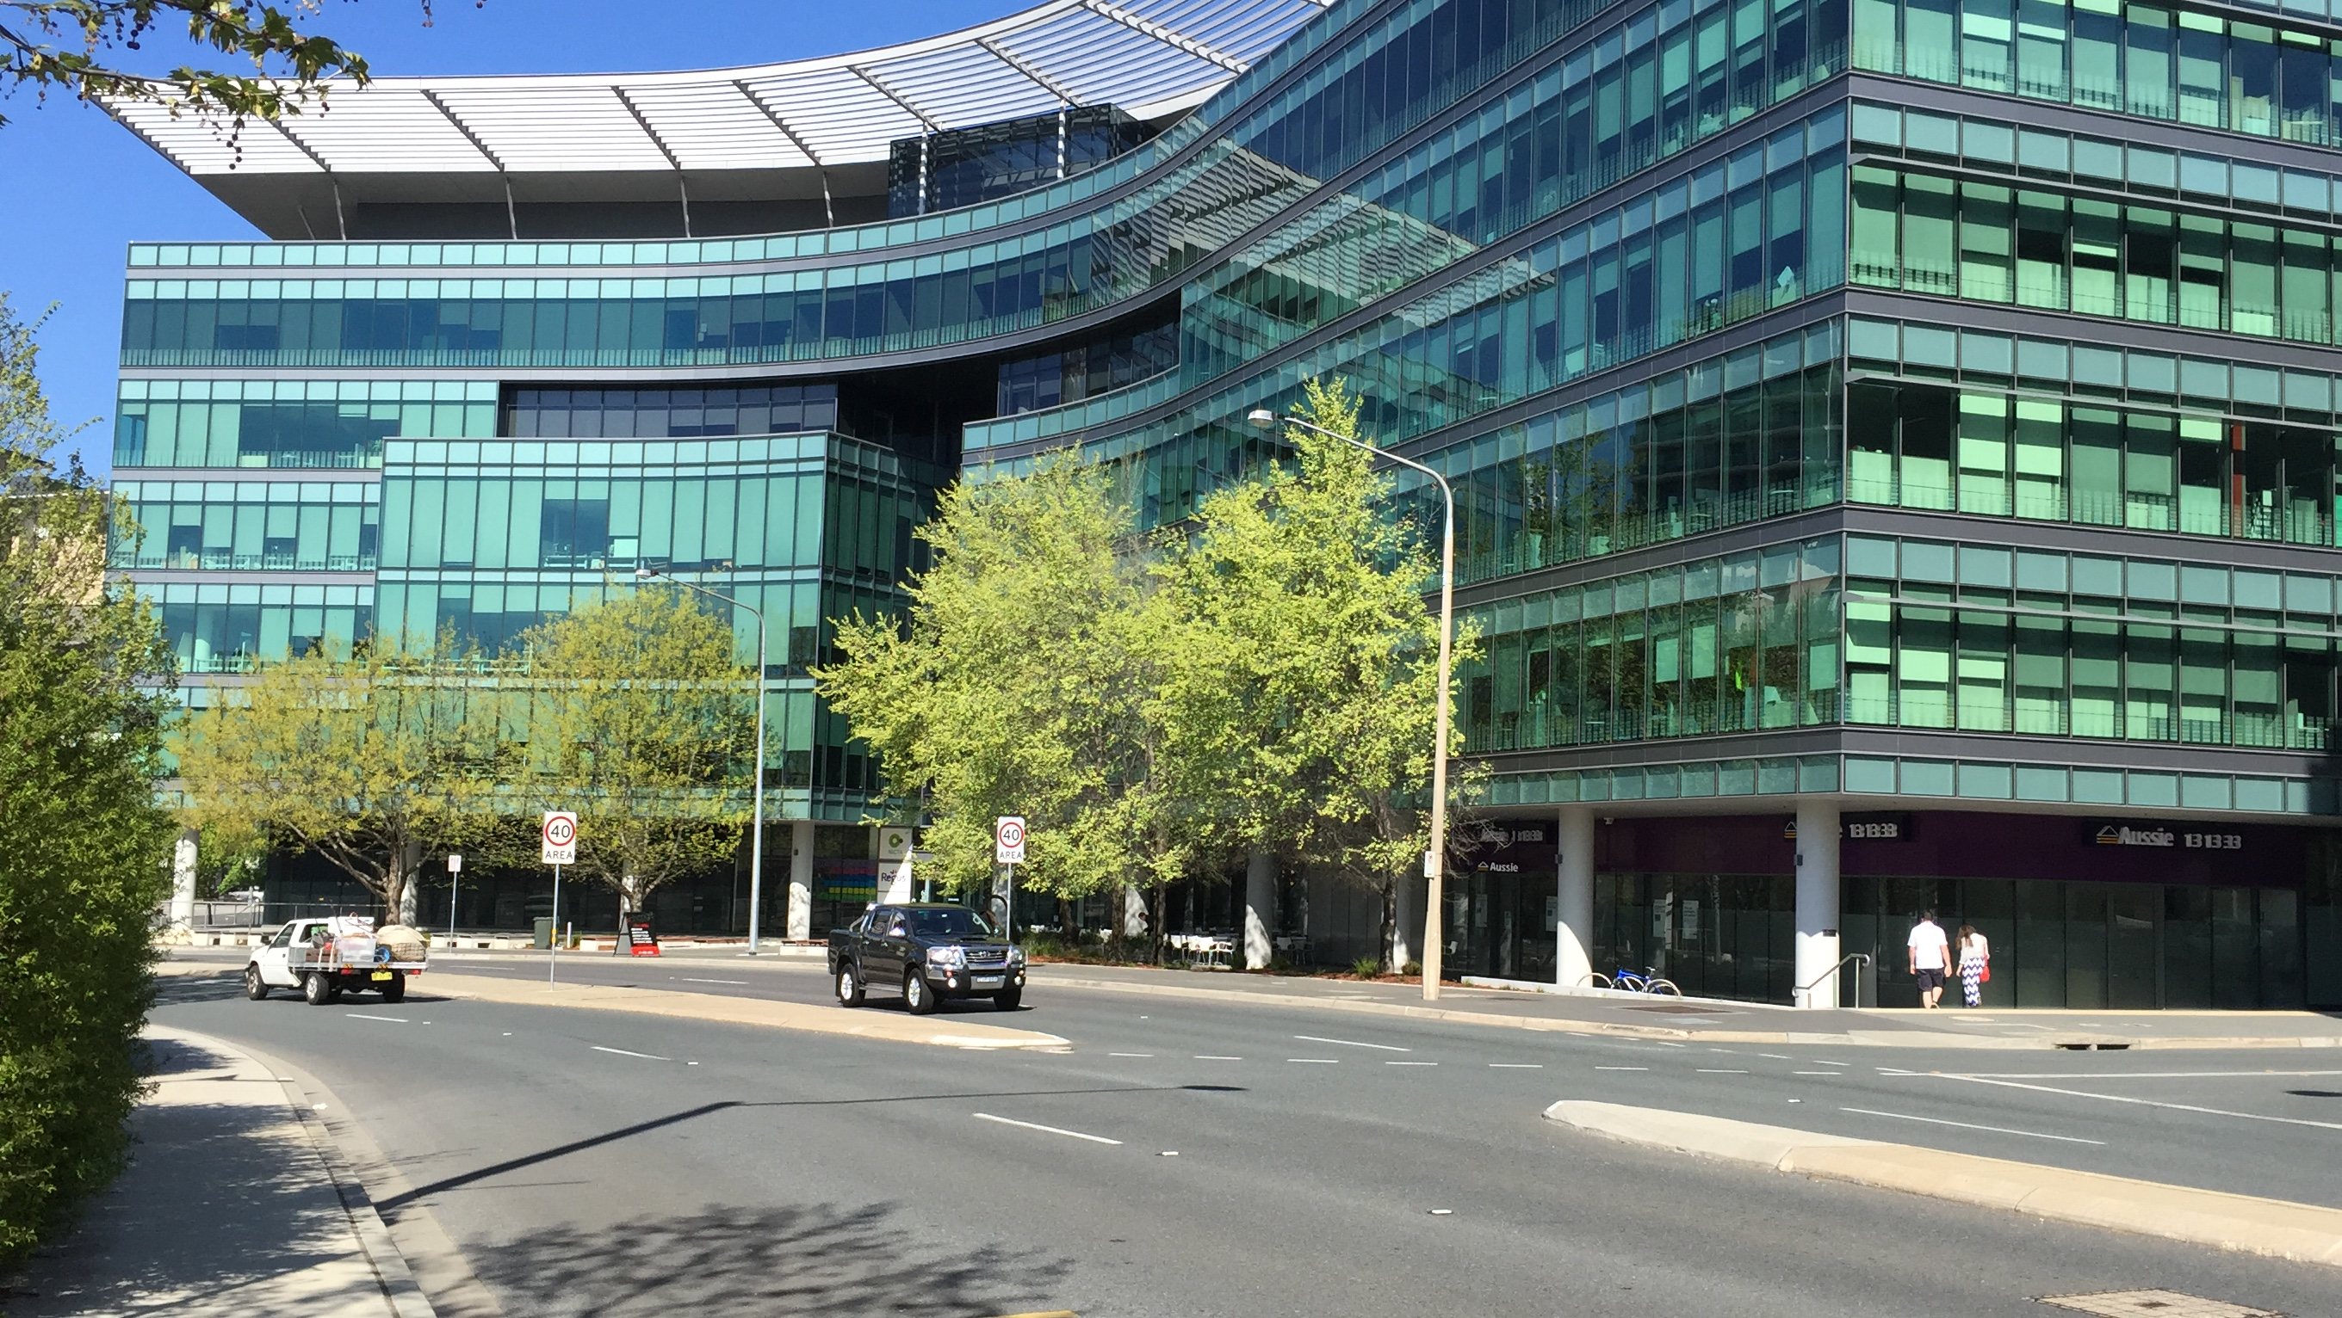
NICTA at Canberra and Sydney

Slide 15
Brief overview of groups at NICTA
Software System (SSRG): Formal Methods, Operating Systems, Software Engineering. Projects such as:
  Theorem provers (HOL, Beagle)
  Software Model Checkers (Goanna)
Optimization. Projects in:
  Constraint solving
  Logistics
  Transport Systems
Andrea was here!
Matteo was here!
Emira was here!

Slide 16
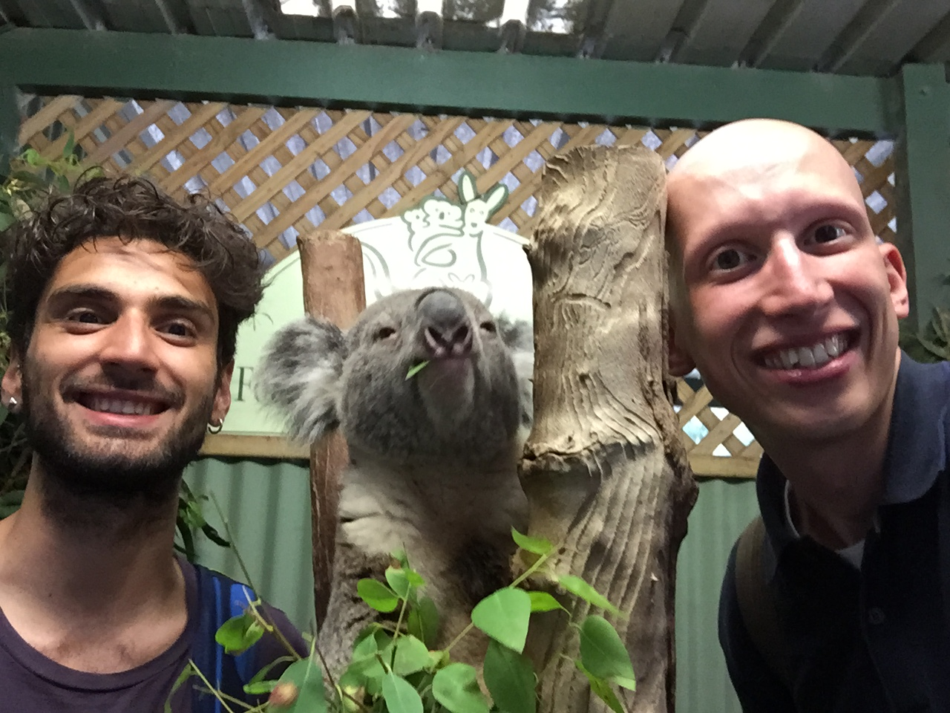
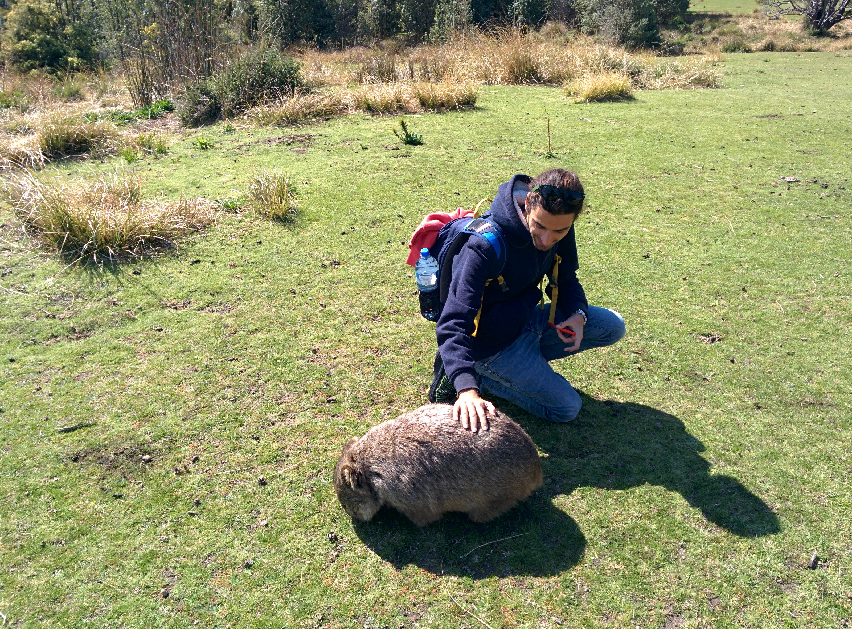

Slide 17
Students who went to NICTA
This year: Andrea & Matteo (us!), Emira (you know her from Dresden)
Previous years, and now in Vienna: Adrian, Medina and Toby
Ask us questions!

Slide 18
